Slide 1
Hotel Booking Cancelation
Michael Albers, Aubrey Kranz, Raegan Storin

Slide 2
Index
01| Proposal Overview
02| Research Question and Hypothesis
03| Data and Methods Plan
04| Schedule
Notes:
Discuss what will be covered in each section!

Slide 3
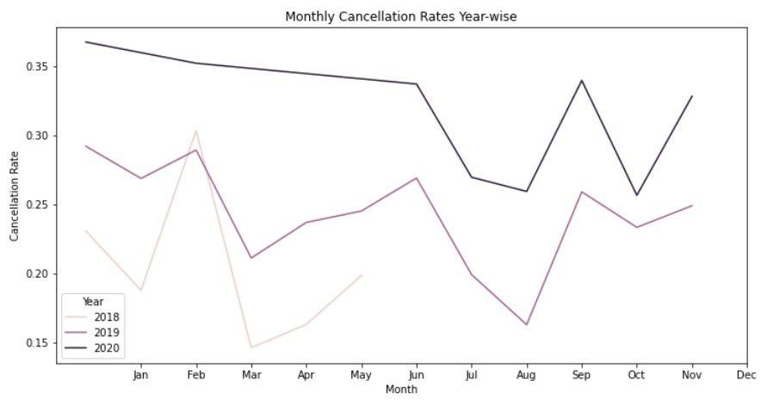
Proposal Overview
What is the problem?
Hotel overbooking can decrease customer satisfaction and negatively impact reputation while underbooking reduces potential revenue.
The goal would be to minimise hotel underbooking without overbooking and exceeding capacity.
(Mutahsim, 2023)
Notes:
The graph in the bottom right visualizes monthly cancellation rates showing a decrease throughout the year with highs spiking during the holidays and beginning of the year.

Slide 4
Research Question and Hypothesis/ Assessment
How can we improve the method of booking or cancellation policies to accurately accomodate for booking cancellations?
Or
Our hypothesis is that we will be able to accurately predict a hotel’s optimal booking capacity by taking into account known factors of historical data.
Notes:
This hypothesis is based on the assumption that there are patterns and relationships between the variables in the dataset that impact booking cancellations, such as lead time, previous cancellations, average daily rate, and seasonality.
Considering that hotels are likely forming similar data analysis to properly increase revenue and run their hotels we will be able to find and build off a body of code developed by a company if necessary.

Slide 5
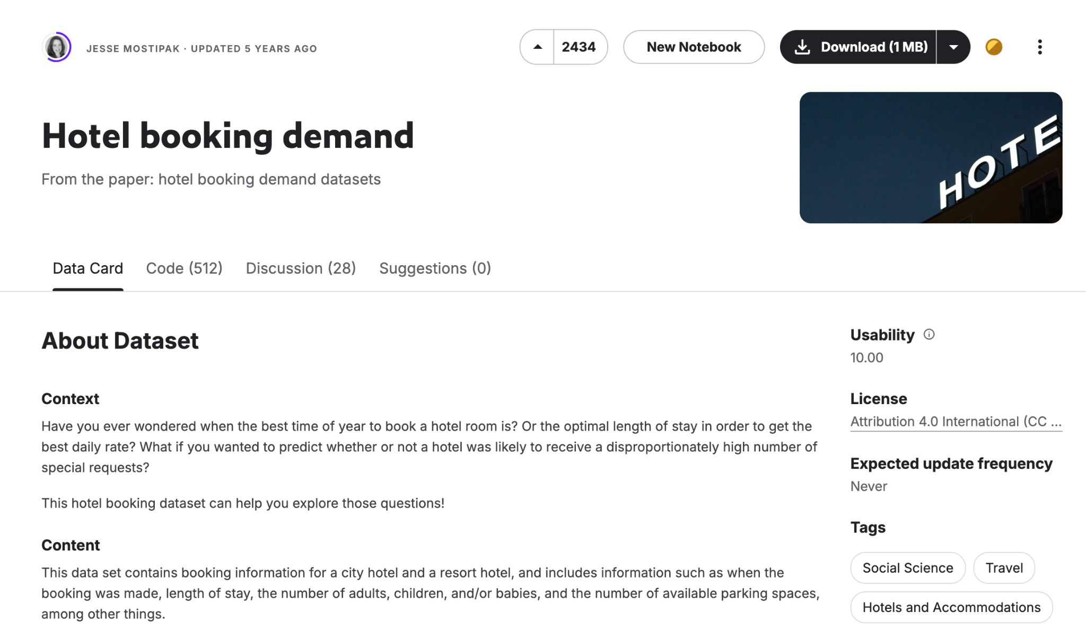
Data and Methods Plan
Our aim is to build a model that can predict hotel booking demand based on a Kaggle hotel booking demand dataset.
By analyzing patterns found in this data, we project seek to provide insights that can help hotels optimize their available bookings.
Variables included
is_canceled
lead_time
arrival_date_year
arrival_date_month
arrival_date_week_number
arrival_date_day_of_month
stays_in_weekend_nights
Stays_in_week_nights
adults
children
babies
meal
Country
market_segment
distribution_channel
is_repeated_guest
previous_cancellations
previous_bookings_not_canceled
Reserved_room_type
assigned_room_type
booking_changes
deposit_type
agent
company
days_in_waiting_list
customer_type
adr
required_car_parking_spaces
total_of_special_requests
reservation_status
reservation_status_date
Notes:
To determine the success of the project, the model's ability to accurately predict effective booking capacity and the relative likelihood of cancellations will be tested against historical data. We will additionally test the model in more specific scenarios, such as the difference in trends between resort versus city hotels, as well as peak or off-peak seasons for travel.

Slide 6
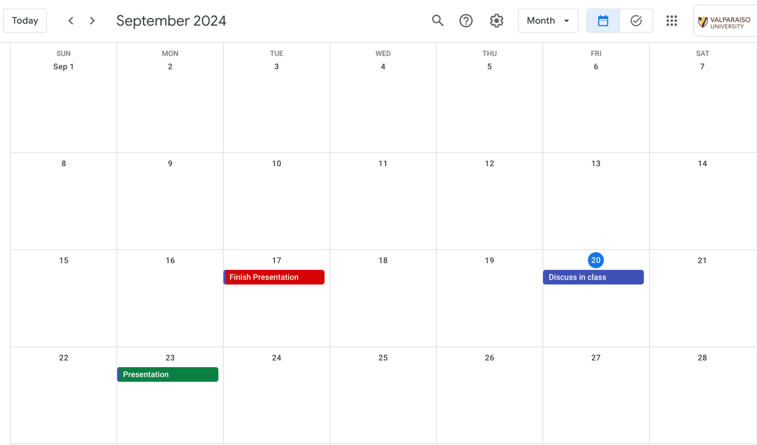
Schedule
Part 1: 9/17 (Presentation 9/23)
Part 2: 10/11 (Presentation 10/18)
Part 3: 11/6 (Draft Paper)
Part 4: 12/3 (Presentation 12/10)
Part 1
All work is to be expected to be completed the night before the lab prior to the due date, according to our internal deadlines.
Notes:
This extra time before the presentation allows our group to take time during labs to look over our work, and see if there are any necessary adjustments as a team.

Slide 7
Sources
https://medium.datadriveninvestor.com/a-python-data-analysis-project-to-understand-hotel-cancellations-fb3f0fee6eea
https://www.kaggle.com/datasets/jessemostipak/hotel-booking-demand/code

